Slide 2
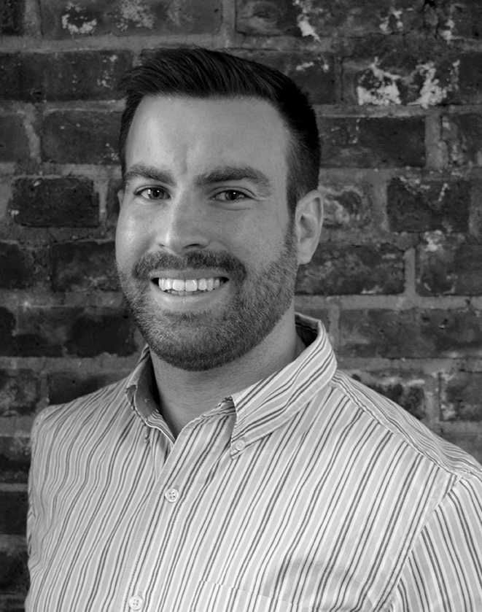
The best fit for Account Planner at Company ABC
Stephen C. Murphy
Contact Stephen
Phone: 732-555-5555
Email: email@address.com
Web: www.mywebsite.com
An experienced digital marketing expert with a flair for the creative and a knack for analytics. I’m eager to join your team!
Employer 1
Digital Marketing Manager > August 2015 - Present
Dependable
Punctual
Dedicated
Analytical
Tech Savvy
Get It Done!
Bullets go here
Bullets go here
Bullets go here
Bullets go here
Employer 2
HMTL & CSS
Adobe Creative Suite
Search Engine Optimization
Google Adwords
Google Analytics Certified
Microsoft Office
Social Advertising
Digital Associate > August 2012 – July 2015
Bullets go here
Bullets go here
Bullets go here
Bullets go here
Employer 3
Marketing Intern > June 2010 – July 2012
Bullets go here
Bullets go here
Bullets go here
Bullets go here
SAMPLE TO SHOW LAYOUT
DELETE ME BEFORE SAVING!
DON’T FORGET TO SAVE AS PDF

